Slide 1


MapStand Global Activity Map Bootstrapping a SaaS Subscription business using GeoNode

Slide 2
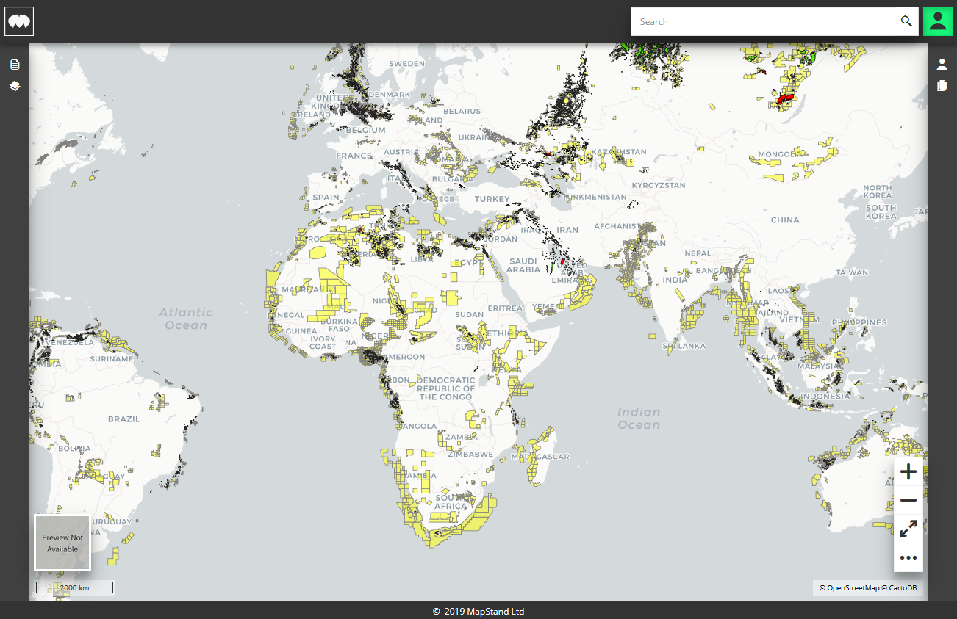
Our vision
Information about the activities of Natural Resource industries (Oil and Gas, Mining) should be in the public domain.
Including information on the Government licensing of land for exploration/exploitation
Activities of companies, Includes planned work, permits, news.
Data should be easily accessible and spatially searchable

Slide 3
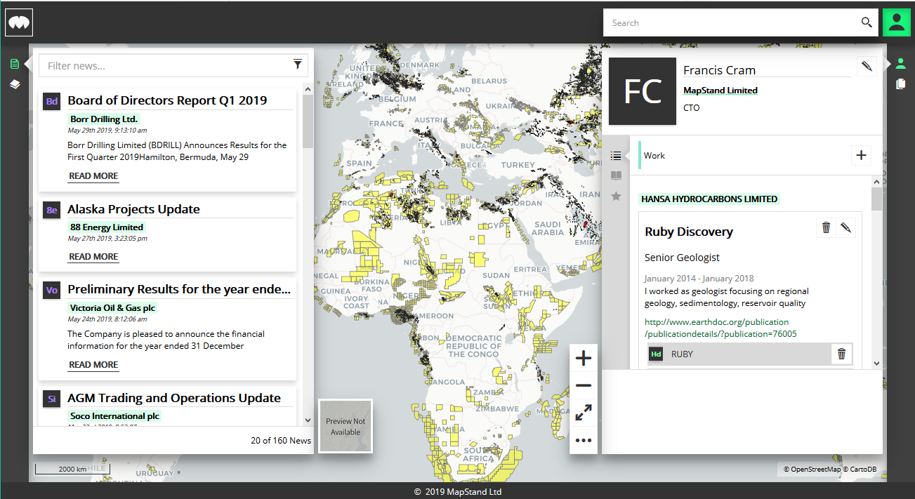
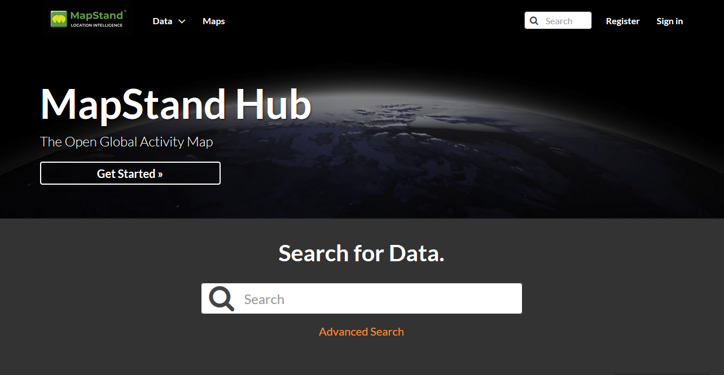
The Birth of MapStand
3 years scouting the basic activity map data
Business model innovation required to support the free access to our data
Start-up launched in August 2018 after raising seed-funding
First paying customer in January 2019 accessing our data through a dedicated GeoNode Instance
April 2019, Multiple test users from different “Groups” accessing data through a single GeoNode.
May 2019 completed second funding round
Beta Launch of platform planned for July 2019
MapStand Platform App
MapStand Hub

Slide 4
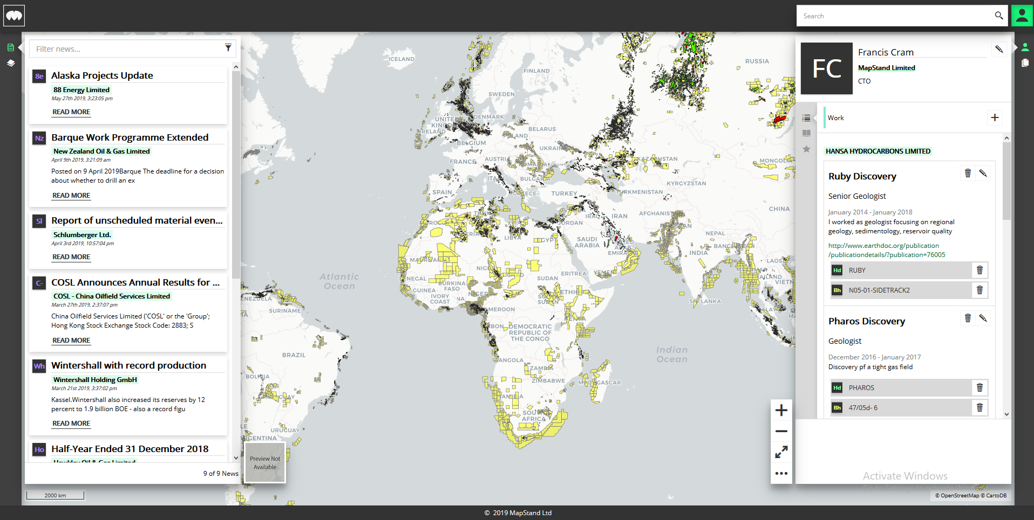
Business Model – The MapStand Platform
Custom Built App using same stack as GeoNode
Django
Geoserver
MapStore2
PostGIS (Amazon RDS)
GeoNode as a service
Fremium Subscription Model
Geotagged global news feed
Interactive activity map
Intuitive Search and Discover
GeoTagged User Profiles
Notes:
Visualise OUR SOLUTION
Our vision is to bring the simple, up-to-date, basic information and data to you via whatever the device and so simply that everyone can use it.
We want to compile data and information from regulatory agencies, operators and news services in one place – with a GIS format
We and to operate just a little bit more openly. We want to make your lives just a little bit easier, you know where the data comes from and how good it is.
Open data is everywhere, revolutionizing government services around the world and changing how public services are delivered, how communities work together and how business is conducted. Open Data is everywhere in our society, yet companies in our business are still paying hundreds of thousands for proprietary data sets.

Slide 5
Early adopters are looking for…
Up-to-date activity map datasets
Hydrocarbon Licence information
Well locations
Location of survey data
Location of key infrastructure
Hydrocarbon Accumulations
Key Vessel (AIS) locations
Up to 20 additional datasets
Web Map Services
WMS/WFS
Data download
Shapefile, csv etc.
Cloud mapping capabilities
Customise, save and share maps privately
Add custom/proprietary content
Basic editing/adding of content to certain layers
Security
Basic analysis/visualization tools
Dashboard
Saved custom queries
Custom Styling

Slide 6
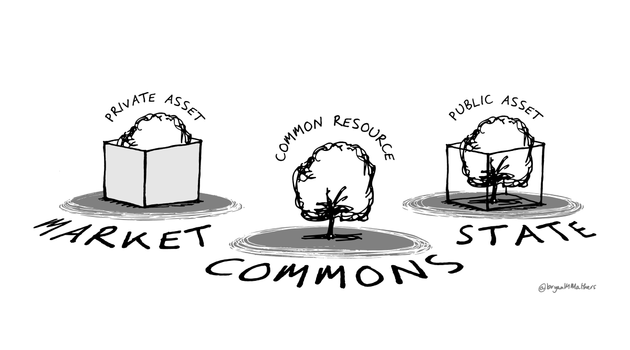

Delivering Open content through a closed system
Open, but not quite
Prior to release our data can’t implement our desired ‘open’ as we are unsure of the provenance or permission on some of our content.
Gaining permissions and porting existing licenses is complex and time consuming.
Data needs to be kept secure during development
Maps produced with our layers by our customers are highly confidential.
Users content is generally confidential

Slide 7
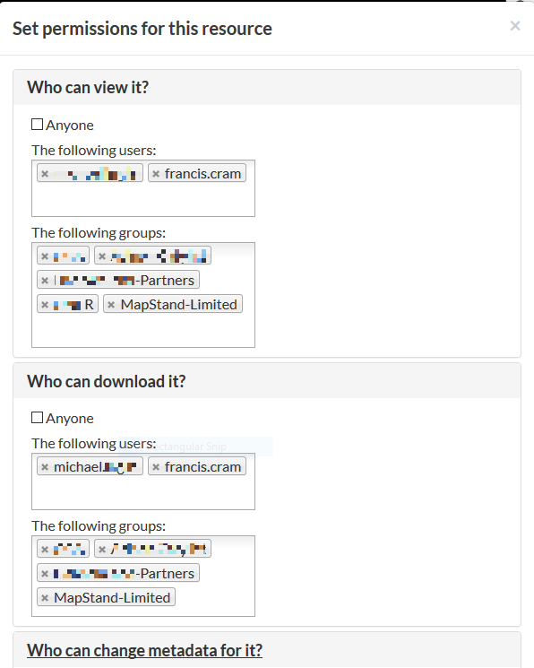
With minimal changes we run version 2.10rc5 with many of the required features
Bootstrapping our requirements…
GeoNode permissions system for managing access at group and individual level.
Require login to see resources | Lockdown = True
Not Open by default | Group Management settings
Template Modifications | Hide about section with users and groups from navbar and info on landing page
Look and Feel | MapStore2

Slide 8
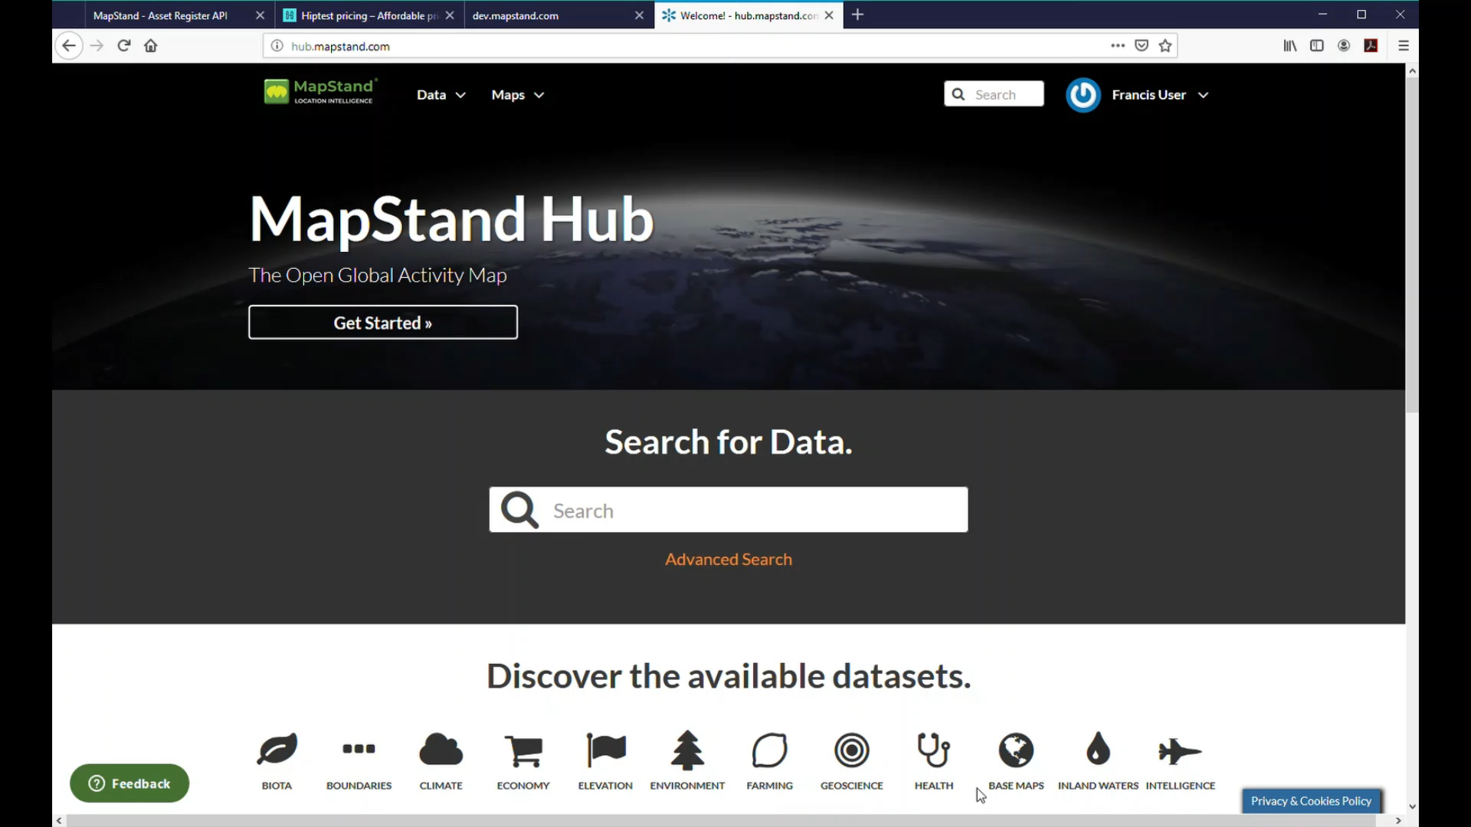
MapStore2 GeoNode Integration

Slide 9

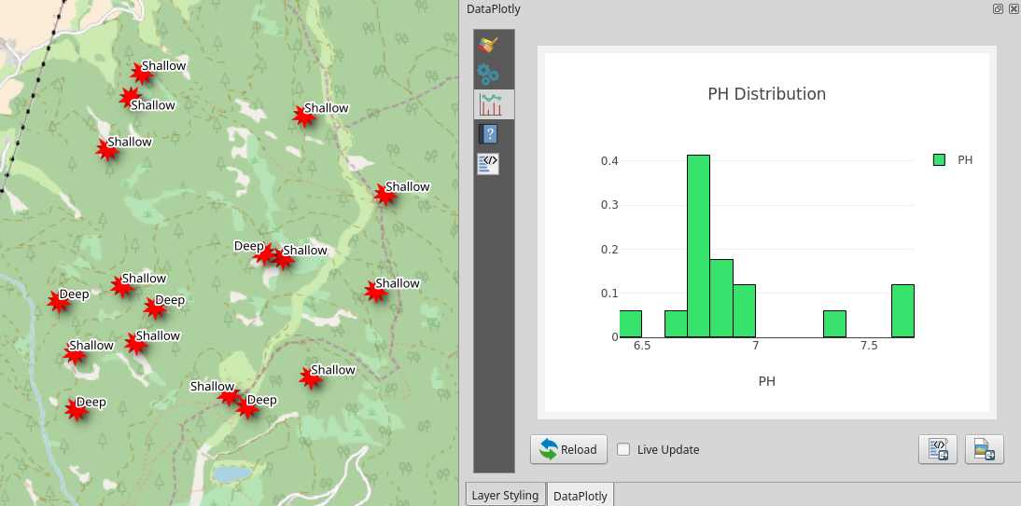
Conclusion
Highlights
We have successfully utilised GeoNode to bootstrap the functionality to provide basic cloud mapping functionality.
OGC webservices with basic authentication work well.
MapStore 2 UI well received
Dashboard functionality useful although very basic and lacks industry standard graph functionalities (i.e Plotly as implemented in QGIS3)
Work to be done
Our requirements to be confidential and secure by default.
Users and Groups not flexible
Multi-tenancy not properly implimend?
Saving filtered map content and custom styles a basic requirement to enable to system to go beyond a catalog/visualisation tool.
Security for private content needs to be by default

